Slide 1

Team 21 Kernel Seekers
team Members Sreesudha Anuvarsha Satya Sasikala Devi Priyambada

Slide 2

Approaches
Implemented Agile methodology for meticulous project planning, ensuring a dynamic and adaptive approach to project
Fostered a collaborative and inclusive work environment by ensuring the equitable distribution of queries among team members, promoting a balanced workload.
Conducted thorough group analysis sessions for all queries, facilitating peer review and leveraging collective insights for enhanced query quality and effectiveness

Slide 3
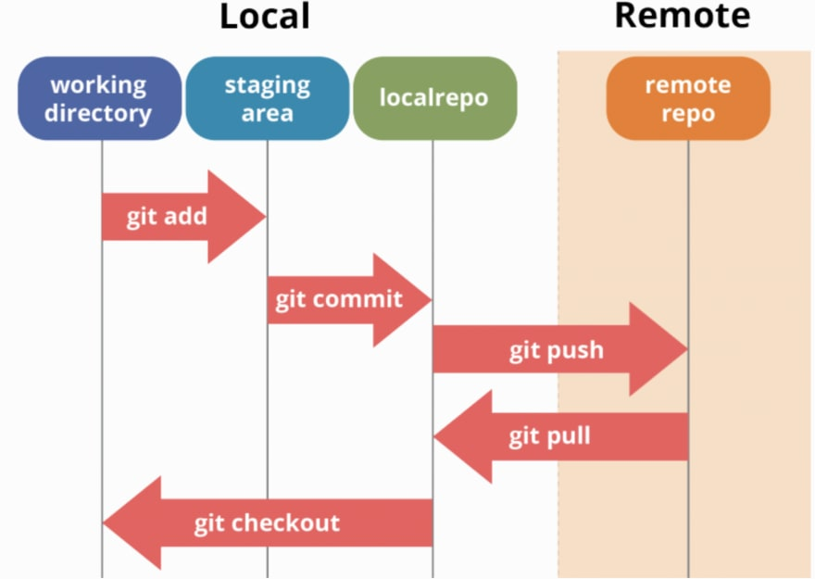
GITHUB
Technical Obstacles
Jupiter checkpoint files were accidently checked into git, unnecessarily causing issues during merges. Added them to .gitignore to avoid accidently check in of those files
Running git pull instruction while the data file was being used actively from Jupiter notebook caused an issue. Had to stop notebook instance while pull/merge instructions were run

Slide 4
Functions And Charts
Simple functions | Advanced Functions | Plots | Basic Charts | Advance Charts
Reshape | Lamda | Scatter Plot | Bar | Histogram
Groupby | idxmax | Box Plot | Line,Pie | Wordcloud
Show | .loc,iloc | Pair PLot | Donut | Heatmap
Rename | Split,Concat, Merge | LinePLot | Sunburst | Violin Chart

Slide 5
Takeaways & Challenges
Accomplishments
Challenges
1)Adhering to the timelines 2)Tool Proficiency
3)Global collaboration 4)Effective Code Management 5)Comprehensive understanding of Hackathon challenges 6)Challenges in extra queries creation 7)Keeping ourselves motivated
1)Proficiency Enhancement in GIT 2)Comprehensive dataset understanding 3)Python Mastery and Library Integration 4)Seamless Integration of Jupiter notebook with SQL 5)Refined Problem solving & Time management skills 6)Exponential growth in Technical knowledge & Expertise

Slide 6
Thank You

Slide 7
QUARTERLY PERFORMANCE

Slide 8
TIMELINE
SEP 20XX | Synergize scalable e-commerce
NOV 20XX | Disseminate standardized metrics
JAN 20XX | Coordinate e-business applications
MAR 20XX | Foster holistically superior methodologies
MAY 20XX | Deploy strategic networks with compelling e-business needs

Slide 9




AREAS OF FOCUS
B2B MARKET SCENARIOS
Develop winning strategies to keep ahead of the competition​
Capitalize on low-hanging fruit to identify a ballpark value​
Visualize customer directed convergence
CLOUD-BASED OPPORTUNITIES
Iterative approaches to corporate strategy​
Establish a management framework from the inside

Slide 10



HOW WE GET THERE
ROI
NICHE MARKETS
SUPPLY CHAINS
Envision multimedia-based expertise and cross-media growth strategies
Visualize quality intellectual capital
Engage worldwide methodologies with web-enabled technologies
Pursue scalable customer service through sustainable strategies
Engage top-line web services with cutting-edge deliverables
Cultivate one-to-one customer service with robust ideas
Maximize timely deliverables for real-time schemas

Slide 11

SUMMARY
At Contoso, we believe in giving 110%. By using our next-generation data architecture, we help organizations virtually manage agile workflows. We thrive because of our market knowledge and great team behind our product. As our CEO says, "Efficiencies will come from proactively transforming how we do business."

